Slide 1
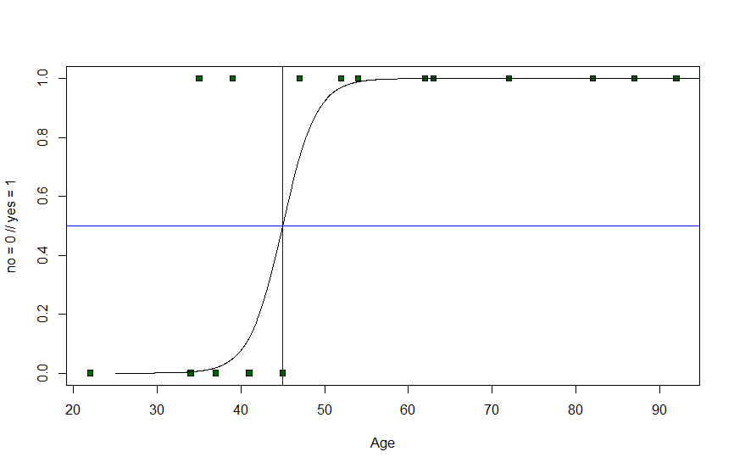
Binomial distribution

Slide 2
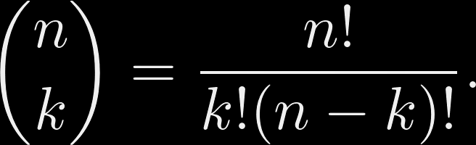

Binomial distribution
Binomial coefficient

Slide 3
Binomial distribution
A coin is flipped 100 times.
What is the probability that it lands on heads at least 70 times?

Slide 4
Binomial distribution
If 20% of customers are willing to buy:
What is the probability that exactly 25 out of 100 customers buy?

Slide 5
Binomial distribution
Binomial experiment:
The number of "successes" in n independent Bernoulli trials.

Slide 6
Binomial distribution
Binomial experiment:
The number of "successes" in n independent Bernoulli trials.

Slide 7
Binomial distribution
Bernoulli trial:
Only two possible outcomes (labelled success and failure, e.g. coin flip).
p probability of "success".

Slide 8
Binomial distribution
Bernoulli trial:
Only two possible outcomes (labelled success and failure, e.g. coin flip).
p probability of "success".
Independent trials:
Result of one trial has no effect on the outcome of the other trial.

Slide 9
Binomial distribution
P(success) = p
P(failure) = 1-p

Slide 10
Binomial distribution
P(success) = p
P(failure) = 1-p
X represents the number of successes in n independent trials.

Slide 11
Binomial distribution
P(success) = p
P(failure) = 1-p
X represents the number of successes in n independent trials.
Binomial distribution

Slide 12
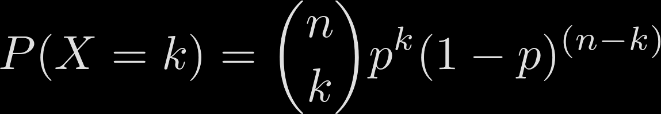

Binomial distribution
X represents the number of successes in n independent trials.

Slide 13

Binomial distribution

Slide 14

Binomial distribution

Slide 15
Binomial distribution
We roll a dice 3 times.
What is the probability a 2 comes up exactly twice?

Slide 16
Binomial distribution
We roll a dice 3 times.
What is the probability a 2 comes up exactly twice?
What is the probability a 2 comes up once, a 3 comes up once and a 4 comes up once?

Slide 17
Binomial distribution
We roll a dice 3 times.
What is the probability a 2 comes up exactly twice?
What is the probability a 2 comes up once, a 3 comes up once and a 4 comes up once?
Not a binomial situation!

Slide 18
Binomial distribution
We roll a dice 3 times.
What is the probability a 2 comes up exactly twice?
Success: Rolling a 2.

Slide 19
Binomial distribution
We roll a dice 3 times.
What is the probability a 2 comes up exactly twice?
Success: Rolling a 2.
Failure: Rolling any other number apart from 2.
X binomial:
p = 1/6
n = 3
k = 2

Slide 20
Binomial distribution
We roll a dice 3 times.
What is the probability a 2 comes up exactly twice?
Success: Rolling a 2.
Failure: Rolling any other number apart from 2.
X binomial:
p = 1/6
n = 3
k = 2

Slide 21
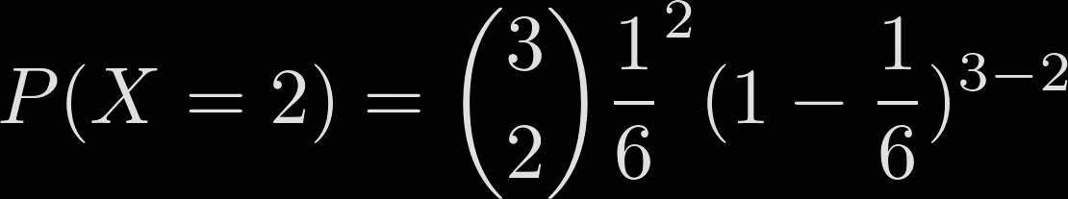
Binomial distribution
We roll a dice 3 times.
What is the probability a 2 comes up exactly twice?
Success: Rolling a 2.
Failure: Rolling any other number apart from 2.
X binomial:
p = 1/6
n = 3
k = 2

Slide 22
Binomial distribution
We roll a dice 3 times.
What is the probability a 2 comes up exactly twice?
S
F

Slide 23
Binomial distribution
We roll a dice 3 times.
What is the probability a 2 comes up exactly twice?
S
S
F
F
S
F

Slide 24
Binomial distribution
We roll a dice 3 times.
What is the probability a 2 comes up exactly twice?
S
S
F
S
S
F
F
F
S
S
F
F
S
F

Slide 25
Binomial distribution
We roll a dice 3 times.
What is the probability a 2 comes up exactly twice?
S
SSS
S
SSF
F
S
SFS
S
F
SFF
F
F
S
FSS
S
FSF
F
F
S
FFS
F
FFF

Slide 26
Binomial distribution
We roll a dice 3 times.
What is the probability a 2 comes up exactly twice?
S
SSS
S
SSF
F
S
SFS
S
F
SFF
F
F
S
FSS
S
FSF
F
F
S
FFS
F
FFF

Slide 27
Binomial distribution
If 20% of customers are willing to buy:
What is the probability that exactly 25 out of 100 customers buy?

Slide 28
Binomial distribution
If 20% of customers are willing to buy:
What is the probability that exactly 25 out of 100 customers buy?

Slide 29
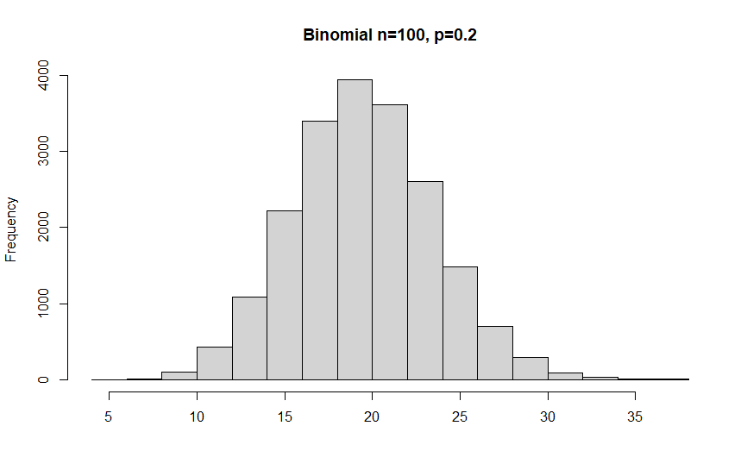
Binomial distribution
If 20% of customers are willing to buy:
What is the probability that exactly 25 out of 100 customers buy?

Slide 30
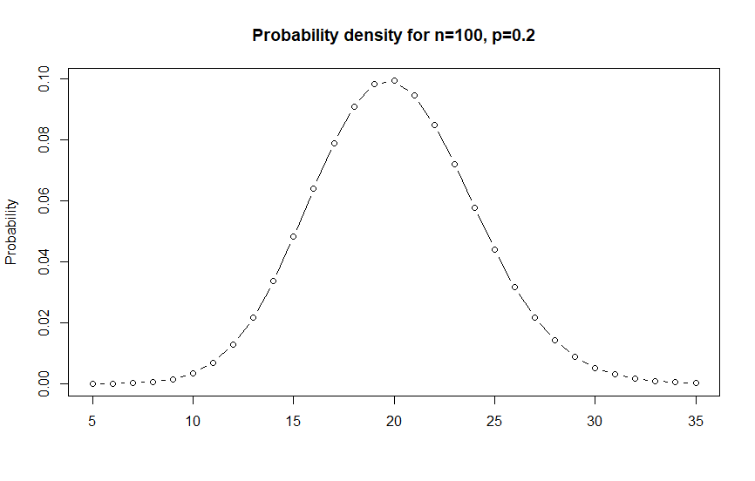
Binomial distribution
If 20% of customers are willing to buy:
What is the probability that exactly 25 out of 100 customers buy?

Slide 31
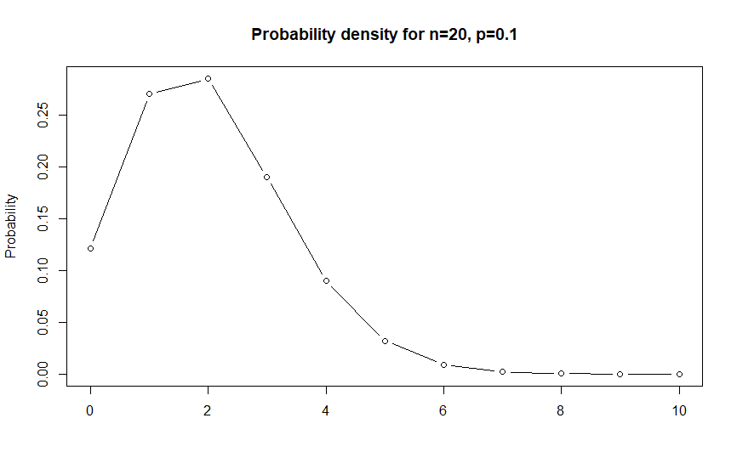
Binomial distribution
If 20% of customers are willing to buy:
What is the probability that exactly 25 out of 100 customers buy?

Slide 32
Binomial distribution
If 80% of customers are willing to buy:
What is the probability that at least 8 out of 10 customers buy?

Slide 33
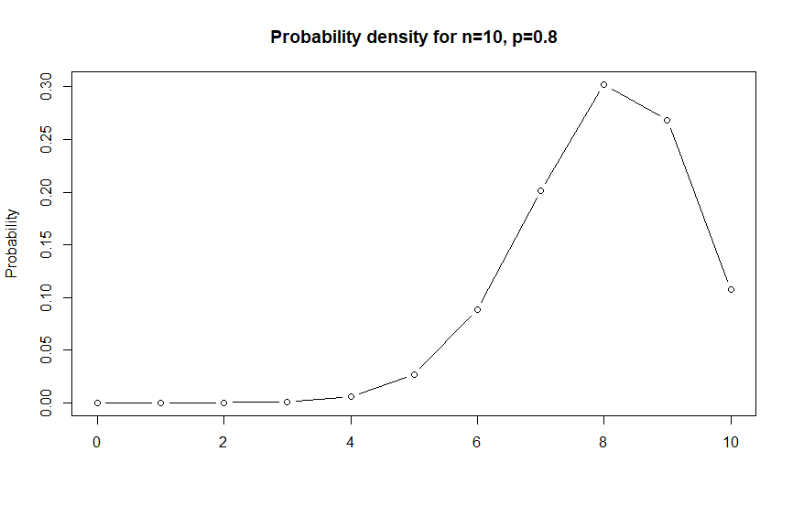
Binomial distribution
If 80% of customers are willing to buy:
What is the probability that at least 8 out of 10 customers buy?

Slide 34
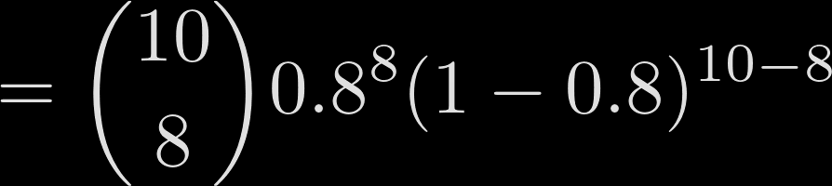
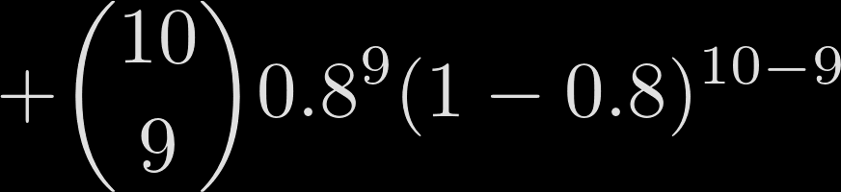
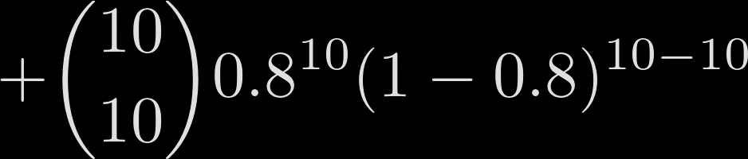
Binomial distribution
If 80% of customers are willing to buy:
What is the probability that at least 8 out of 10 customers buy?

Slide 35
Binomial distribution
If 80% of customers are willing to buy:
What is the probability that at least 8 out of 10 customers buy?
0.677
0.302
0.268
0.107

Slide 36
Poisson distribution

Slide 37
Poisson distribution
Discrete Distribution

Slide 38
Poisson distribution
Discrete Distribution
Number of events occurring in a
time interval or region of opportunity

Slide 39
Poisson distribution
Discrete Distribution
Number of events occurring in a
time interval or region of opportunity
How many customers enter a store in one hour

Slide 40
Poisson distribution
Discrete Distribution
Number of events occurring in a
time interval or region of opportunity
How many customers enter a store in one hour
λ = 4
Only parameter λ – expected value
Possible values reaching from 0 to ∞

Slide 41
Poisson distribution
Assumptions
Rate at which the events occur is constant over time
λ = 4
The events are independent

Slide 42
Poisson distribution
Density function (p.m.f.)
$P\left(X=k\right)=\frac{ⅇ^{−λ}λ^{k}}{k!}$
λ = 4

Slide 43
Poisson distribution
Density function (p.m.f.)
$P\left(X=k\right)=\frac{ⅇ^{−λ}λ^{k}}{k!}$
λ = 4
$P\left(X=5\right)=\frac{ⅇ^{−4}4^{5}}{5!}$ $=$ 0.1563
0.1563

Slide 44
Poisson distribution
Density function (p.m.f.)
$P\left(X=k\right)=\frac{ⅇ^{−λ}λ^{k}}{k!}$
λ = 4
$P\left(X=5\right)=\frac{ⅇ^{−4}4^{5}}{5!}$ $=$ 0.1563
0.1563

Slide 45
Poisson distribution
Density function (p.m.f.)
$P\left(X=k\right)=\frac{ⅇ^{−λ}λ^{k}}{k!}$
λ = 4
$P\left(X=5\right)=\frac{ⅇ^{−4}4^{5}}{5!}$ $=$ 0.1563
0.1563
= POISSON.DIST(5,4,FALSE)

Slide 46
Poisson distribution
Density function (p.m.f.)
$P\left(X=k\right)=\frac{ⅇ^{−λ}λ^{k}}{k!}$
λ = 4
$P\left(X=5\right)=\frac{ⅇ^{−4}4^{5}}{5!}$ $=$ 0.1563
0.1563
= POISSON.DIST(5,4,FALSE)

Slide 47
Poisson distribution
Density function (p.m.f.)
$P\left(X=k\right)=\frac{ⅇ^{−λ}λ^{k}}{k!}$
λ = 4
$P\left(X=5\right)=\frac{ⅇ^{−4}4^{5}}{5!}$ $=$ 0.1563
0.1563
= POISSON.DIST(5,4,FALSE)

Slide 48
Poisson distribution
Density function (p.m.f.)
$P\left(X=k\right)=\frac{ⅇ^{−λ}λ^{k}}{k!}$
λ = 4
$P\left(X=5\right)=\frac{ⅇ^{−4}4^{5}}{5!}$ $=$ 0.1563
0.1563
= POISSON.DIST(5,4,FALSE)

Slide 49
Poisson distribution
Cumulative density function (c.d.f.)
$P\left(X≤n\right)=ⅇ^{−λ}\sum_{k=0}^{n}{\frac{λ^{k}}{k!}}$
= POISSON.DIST(5,4,TRUE)

Slide 50
Poisson distribution
Cumulative density function (c.d.f.)
$P\left(X≤n\right)=ⅇ^{−λ}\sum_{k=0}^{n}{\frac{λ^{k}}{k!}}$
= POISSON.DIST(5,4,TRUE) =0.785

Slide 51
Poisson distribution
Expected value:
$E\left(X\right)=$ $λ$

Slide 52
Poisson distribution
Expected value:
$E\left(X\right)=$ $λ$
Variance:
$V\left(X\right)=$ $λ$

Slide 53
Poisson distribution
λ = 4
λ = 1
λ = 7
λ = 9

Slide 54
Poisson distribution
λ = 4
λ = 1
λ = 7
λ = 9

Slide 55
Poisson distribution
λ = 4
λ = 1
λ = 7
λ = 9

Slide 56
Poisson distribution
λ = 1
λ = 4
λ = 7
λ = 9

Slide 57
Poisson distribution
λ = 1.3

Slide 58
Poisson distribution
You work for a Canadian Outdoor Company as Data Scientist.
The company has started to advertise on Google to direct traffic to their sales page.
The number of sales from the ads is Poisson distributed with a mean of λ= 14 sales per day.

Slide 59
Poisson distribution
Questions:
What is the probability for…
… getting exactly 12 sales in a day
… getting not more than 12 sales in a day
… getting more than 12 sales in a day?

Slide 60
Poisson distribution
Questions:
What is the probability for…
… getting exactly 12 sales in a day
… getting not more than 12 sales in a day
… getting more than 12 sales in a day?
Is the Poisson distribution realistic for this scenario?

Slide 61
Poisson distribution
… getting exactly 12 sales in a day
λ = 14

Slide 62
Poisson distribution
… getting exactly 12 sales in a day
λ = 14
$P\left(X=12\right)=\frac{ⅇ^{−14}{14}^{12}}{12!}$ $=$ 0.0984
= POISSON.DIST(12,14,FALSE)

Slide 63

Poisson distribution
2) … getting not more than 12 sales in a day
λ = 14
$P\left(X≤12\right)=ⅇ^{−14}\sum_{k=0}^{12}{\frac{{14}^{k}}{k!}}=$ 0.358
= POISSON.DIST(12,14,TRUE)

Slide 64
Poisson distribution
3) … getting more than 12 sales in a day
λ = 14
$P\left(X>12\right)=1−P\left(X≤12\right)$ = 0.642
= POISSON.DIST(12,14,TRUE)

Slide 65
Poisson distribution
3) … getting more than 12 sales in a day
λ = 14
$P\left(X>12\right)=1−P\left(X≤12\right)$ = 0.642
= POISSON.DIST(12,14,TRUE)

Slide 66
Poisson distribution
4) … is it a realistic scenario?
Rate at which the events occur is constant over time
The events are independent

Slide 67
Example problems

Slide 68
Example problems
=BINOM.DIST(number of success, number of trials, cumulative or not)
=POISSON.DIST(number of successes, expected value, cumulative or not)

Slide 69
Example problems
Imagine you are working for an event management company.
At an event the want to use a gaming device.
Since this gaming device is a bit delicate it can break easily.
The probability that is will break in our event is 0.12.
Therefore they will bring also 3 backup devices.
Now your manager is asking you, what is the probability that two out of the 4
devices will break.

Slide 70
Example problems
Requirements:
- Success and Failure probability
- Devices work independently
Imagine you are working for an event management company.
At an event the want to use a gaming device.
Since this gaming device is a bit delicate it can break easily.
The probability that is will break in our event is 0.12.
Therefore they will bring also 3 backup devices.
Now your manager is asking you, what is the probability that two out of the 4
devices will break.

Slide 71

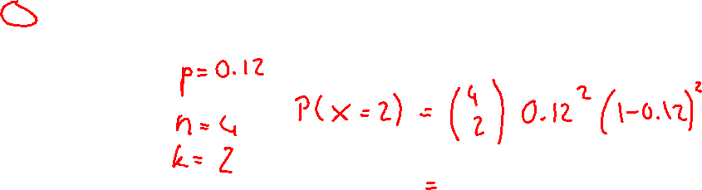
Example problems
Requirements:
- Success and Failure probability
- Devices work independently
Imagine you are working for an event management company.
At an event the want to use a gaming device.
Since this gaming device is a bit delicate it can break easily.
The probability that is will break in our event is 0.12.
Therefore they will bring also 3 backup devices.
Now your manager is asking you, what is the probability that two out of the 4
devices will break.

Slide 72
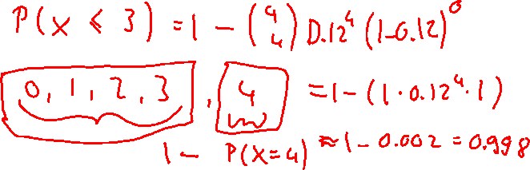
Example problems
Requirements:
- Success and Failure probability
- Devices work independently
What is the probability that at least
one devices will still work?

Slide 73
Example problems
You are working in a car company that is selling sports cars.
We know that in average there are 15 people coming into our show room per day.
Assuming the number of people entering our show room is Poisson distributed, what is the probability that exactly 20 people enter our room?

Slide 74
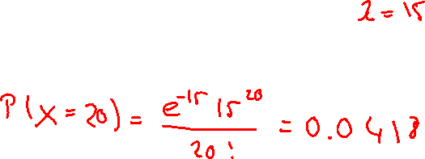
Example problems
You are working in a car company that is selling sports cars.
We know that in average there are 15 people coming into our show room per day.
Assuming the number of people entering our show room is Poisson distributed, what is the probability that exactly 20 people enter our room?
$P\left(X=k\right)=\frac{ⅇ^{−λ}λ^{k}}{k!}$

Slide 75
Example problems
We know 60% of our customers are men. We usually have 10 customers buying a car per day.
What is the probability that exactly 8 out of 10 customers are men in a certain day?

Slide 76
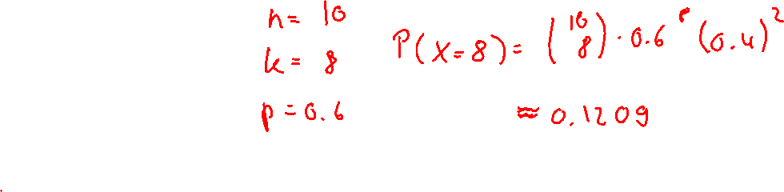
Example problems
We know 60% of our customers are men. We usually have 10 customers buying a car per day.
What is the probability that exactly 8 of our customers are men in a certain day?

Slide 77
Poisson distribution
If 80% of customers are willing to buy:
What is the probability that at least 8 out of 10 customers buy?
0.677
0.302
0.268
0.107

